Slide 1


CMC Template

Slide 2

What is the CMC?
Content Management Catalogue
The Content Management Catalogue (CMC) is a template tool that allows us to:
Control the offers in creative variants without having to create new variants
No need to redeploy
Schedule offers
Saving valuable time and making the DCO process much more efficient.

Slide 3
What are the Benefits?
Content Management Catalogue
1. Improve efficiencies by updating multiple variants at once
2. Give VW more power and visibility over their messaging
3. Quick real time Offer updates – that don’t require redeployments

Slide 4



Deployment Process – Existing
Content Management Catalogue
Supply audience names & Sizmek keywords to Engine DCO, via working document
Load audiences into Orca and notify PHD & Creative Agency
Creative Agency to build variants for the relevant audience names
Duplicate existing variants and update them with new offer / creative refresh
OFFER / CREATIVE UPDATED
Feedback or Approve creative variants
Add new/updated landing page URLs with UTM tracking to each variant within Orca. Once done, set variant/s Live.
Engine DCO to deploy from Orca, assign ads to Sizmek Ad Ids and map audiences.
Set campaign live in DSP and set up daily reports in Sizmek to be sent to Engine DCO.

Slide 5
Deployment Process – With CMC
Content Management Catalogue
As the variant is already live, there is no need to redeploy or set live – it all happens in real time
Supply audience names & Sizmek keywords to Engine DCO, via working document
Load audiences into Orca and notify PHD & Creative Agency
Creative Agency to build variants for the relevant audience names
The client provides the offer copy for Creative Agency to schedule using the CMC
OFFER / CREATIVE UPDATED

Slide 6
Key Definitions & Usage Instructions
Content Management Catalogue
Key Terms | Description
Content Management Catalogue (CMC) | Adylic’s pre-built API functionality. Useful for copy uploads within multiple creative variants. Eg. Monthly offers
Content Group | Grouping for Dynamic Content, recommended by model but could be also used for events or other relevant grouping
Dynamic Content | Overarching grouping for each editable section e.g. Model, Copy. Ensure you are using the same dynamic content section for all offers to avoid needing to update the API Key this within the Orca variant
API Key | An automatically generated code which is attached to a dynamic content group. The key will need to be added to the related section within the ORCA template to connect the value/dynamic content
Default Value | The content which will be displayed within the variant, unless time specific content is added. Once the time specific content has expired, this content will preview.
Versions | The optional for automatically scheduled time specific values (copy, terms etc.) to be added to the creative. Once the time specific content has expired, the content will revert to the default value
Value | Similar to the default value but is the content which will only show during time and dates specified within the version section

Slide 7
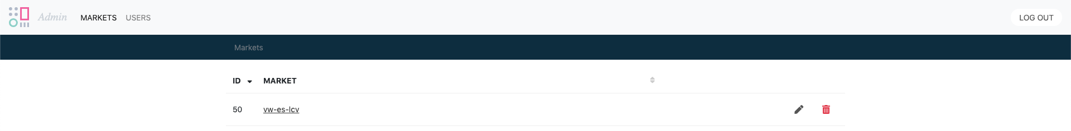
Using the CMC
Content Management Catalogue
Once you’ve signed into the CMC here, you’ll the be on the Market Profile page. Content for your market will be housed under the “vw-market” market.
TIP! Clicking on the headers on the page (this page and subsequent pages) will order the columns contents accordingly. So clicking on ID will order the contents by number and clicking on Market will order alphabetically.

Slide 8
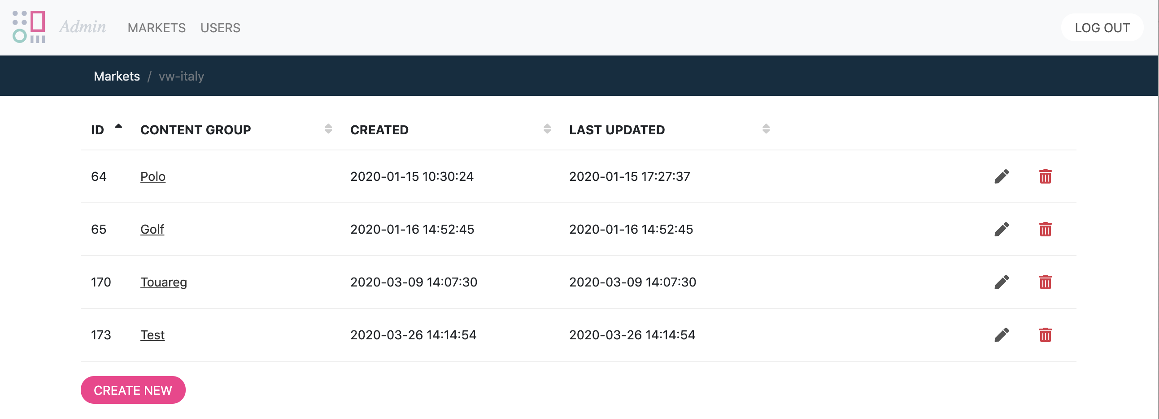
Content Groups
Content Management Catalogue
When you click into a market you enter the Content Groups section.
In this section you can edit and create new Content Groups, which act as collections of the content you would like scheduled or added in rotation to the variants
Example: ‘Offers’ could be the name of a content group populated with standard offers; another content group could be ‘Specials’ which would be a group of special one-off offers. Or you could split this up by model.

Slide 9
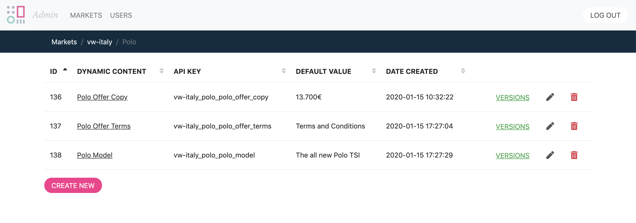
Dynamic Content
Content Management Catalogue
This is a more granular and specific version of a content group. In Dynamic Content you can set the default value. The default value is what will serve as copy if there is nothing scheduled to run in the Versions.
The Dynamic Content page is the first introduction of the API Key. The API Key is how the Variants in ORCA and CMC will communicate. The API Key must be copied into the Variants exactly when the variants are being created.
It’s a concatenation of Client Profile_Content_Group_ Dyanmic Content

Slide 10
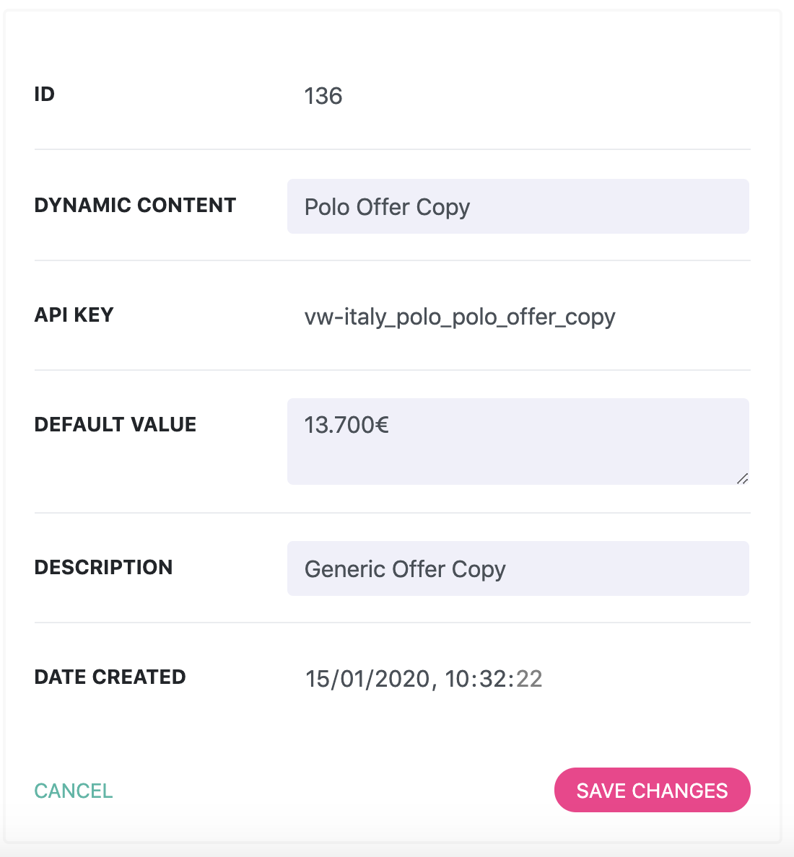
Dynamic Content
Content Management Catalogue
This is the view for setting the Dynamic Content default value. Under “Dynamic Content” you should create a name for the content. Under “Default Value” you should insert the copy you would like to appear within the variant.
Overarching grouping for each editable section e.g. Model, Copy
The content which will be displayed within the variant, unless time specific content is added
More information on what the value is

Slide 11
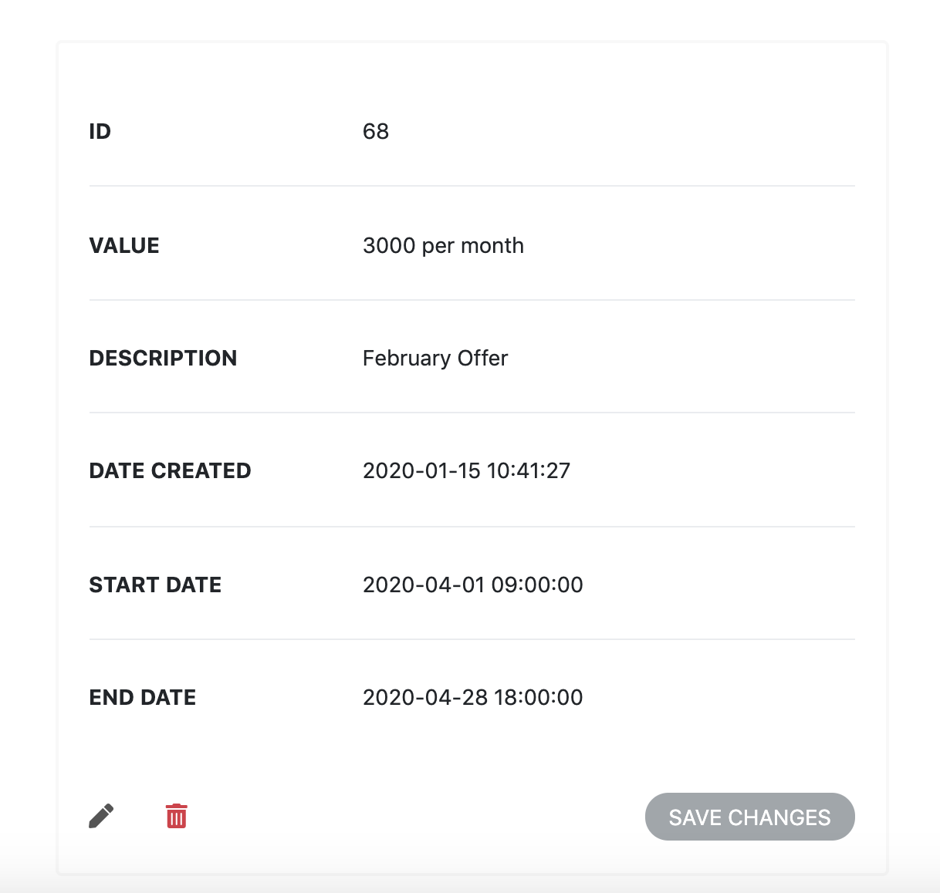
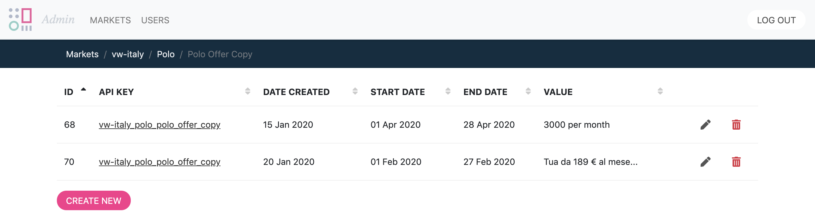
Date & Time based offer deployment
Content Management Catalogue
When you have defined your dynamic content you can then create new versions of that dynamic content – versions that you can schedule accordingly. It is here in versions that you can have an overview of all your offers; you can also easily create and delete existing versions.

Slide 12
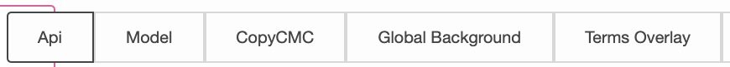
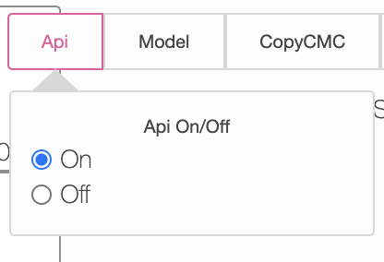
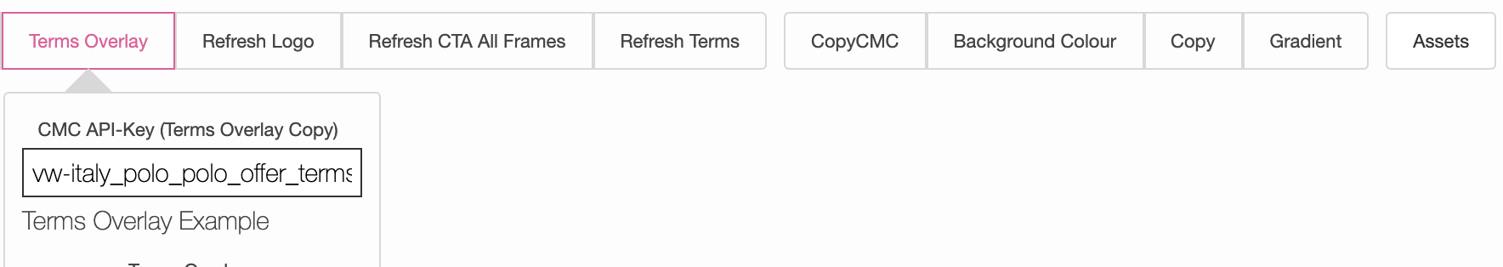
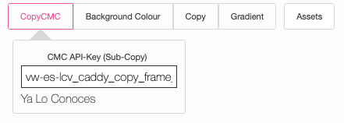
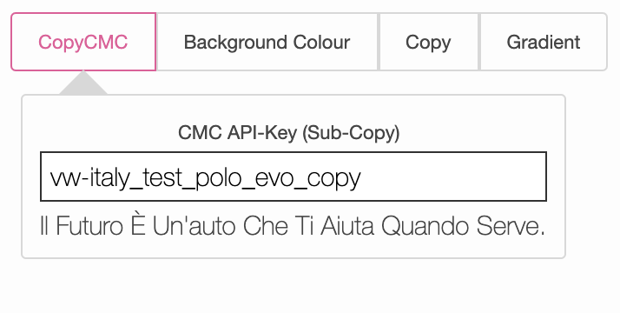
CMC within ORCA
1
3
2
4
1
This is where the API functionality is switched on or off and determines if the API key will be pulled in or not. *Please note when on anything pulled in from the API will override any manual copy inserted.
2
This is where the API Key for the Terms Overlay is inserted. *Please note you will still need to place the copy for the terms overlay button in the “Refresh Terms” Tab.
This is where the API Key for the Display Copy is inserted into. #3 is for copy over all frames #4 is for frame specific copy.
3
4

Slide 13
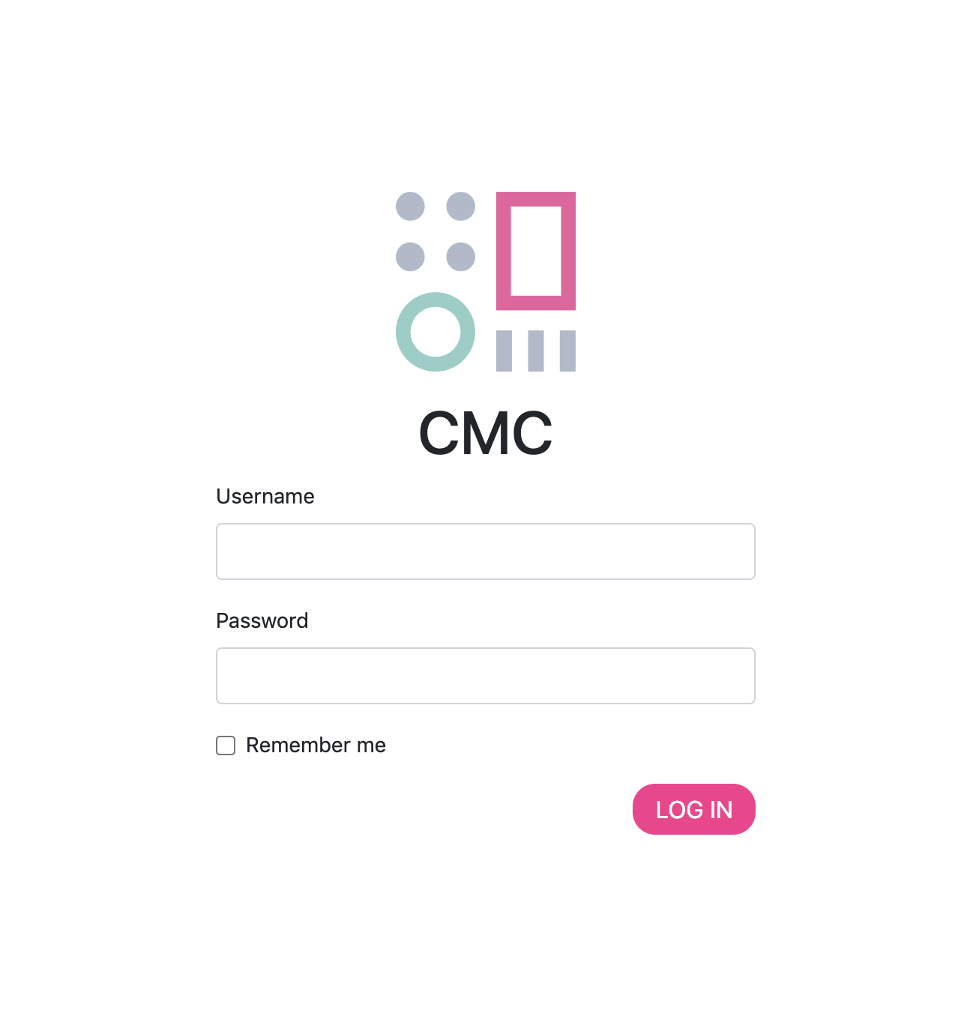
CMC DEMO
Content Management Catalogue
https://cmc.adylicorca.com/login

Slide 14

Thank you

